Slide 1




Executive Overview
Access & Wait Time
Cost & Billing
Patient Satisfaction

Slide 2
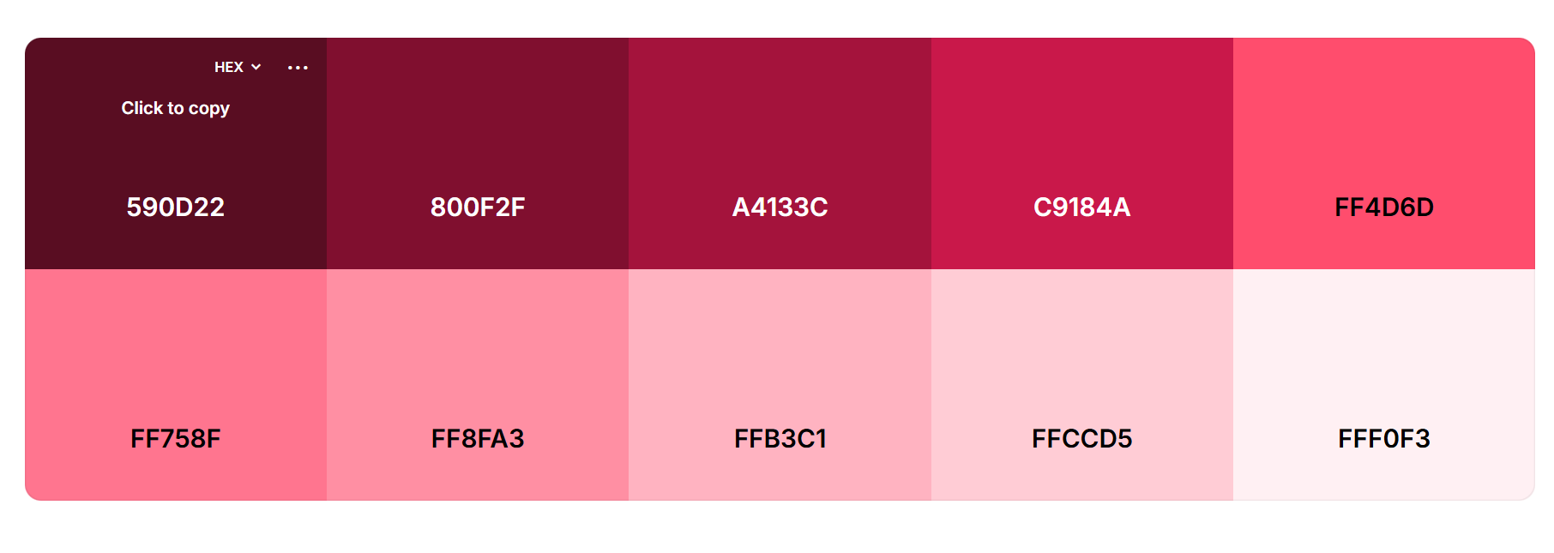


Executive Overview
Access & Wait Time
Cost & Billing
Patient Satisfaction

Slide 3

Executive Overview
Access & Wait Time
Cost & Billing
Patient Satisfaction

Slide 4

Executive Overview
Access & Wait Time
Cost & Billing
Patient Satisfaction

